Slide 1
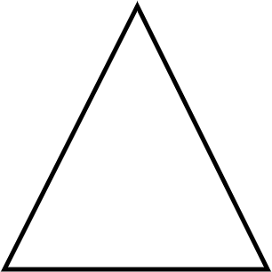
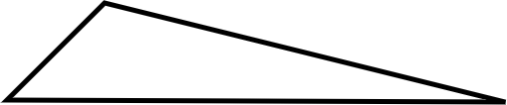


Problem solving with place value
Task A: Same measure, different units
Here is an important reminder about two types of triangles.
An isosceles triangle has two sides which are the same length.
A scalene triangle has no sides with the same length.
For each set of measurements, deduce if they are the lengths of a scalene or an isosceles triangle.
1) 1.739 m, 173.9 cm, 1793 mm
2) 0.032 km, 3020 cm, 32 000 mm
3) 5.1 cm, 0.000053 km, 50.3 mm
4) Izzy has measured the sides of a triangle.
Why might you think that Izzy has made an error?
How could you check?
I measured lengths of 31.2 cm, 24.9 cm and 9.3 mm

Slide 2
Problem solving with place value
Task B: Determining useful units of measure
1) Fill in the gaps using an appropriate unit of measure from the box.
I recently visited Paris. It took 2 and 37 . to get there by train. I visited the Eiffel Tower, which is 330 tall. Whilst at the Eiffel Tower, I visited a souvenir shop and bought 0.5 of sweets to share with my friends.
grams kilograms millimeters centimeters metres kilometers seconds minutes hours millilitres
2) Which metric measures might be used to measure the following?
a) Length of an ant
b) Mass of a person
c) Capacity of a bucket
d) Height of a house
3) Which imperial measures might be used to measure the following?
a) Length of an ant
b) Mass of a person
c) Capacity of a bucket
d) Height of a house
Mathematics in Education and Industry
v2.1

